Slide 1
Landwirtschaftskammerwahl 24. Jänner 2021
Analyse – endgültiges Endergebnis

Slide 2
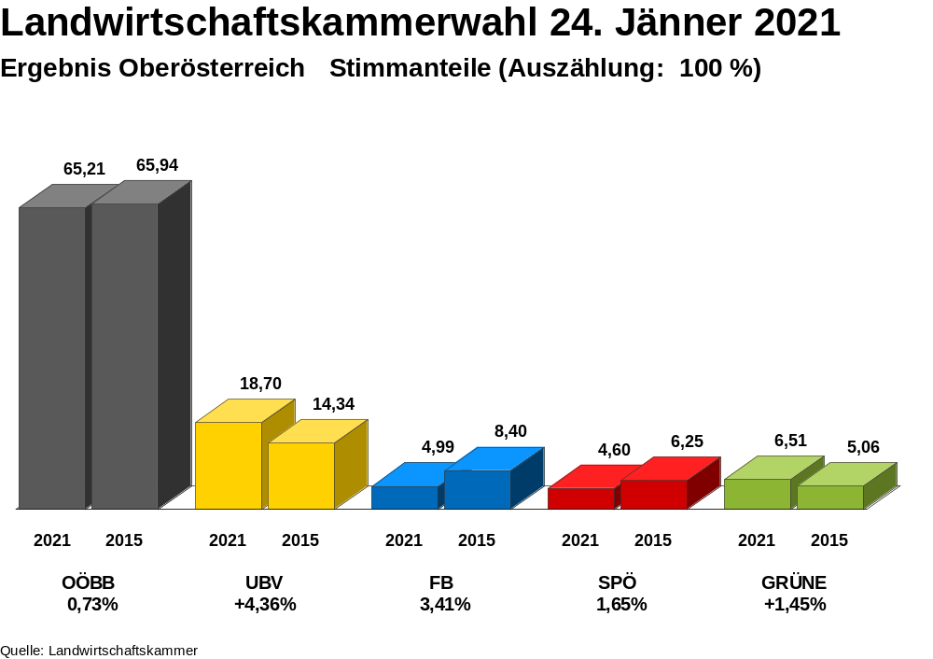
Notes:
erg_4_pct.emf

Slide 3
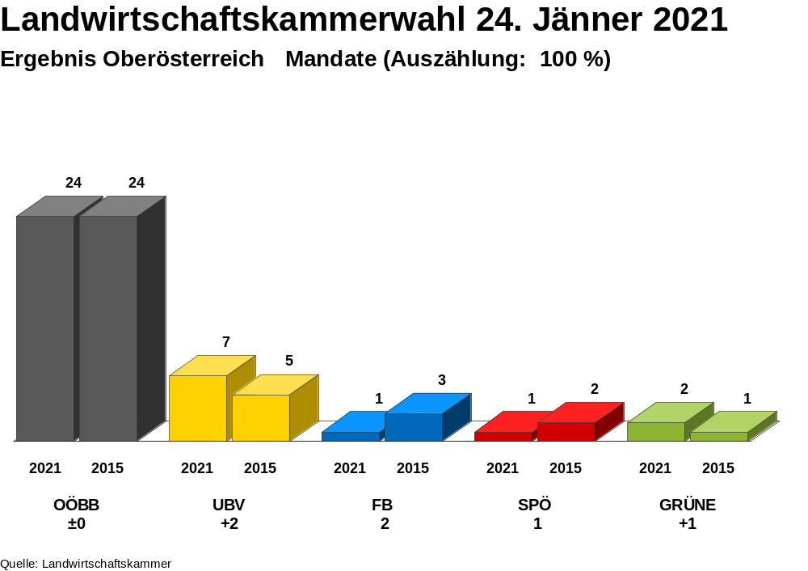
Notes:
erg_4_mand.emf

Slide 4
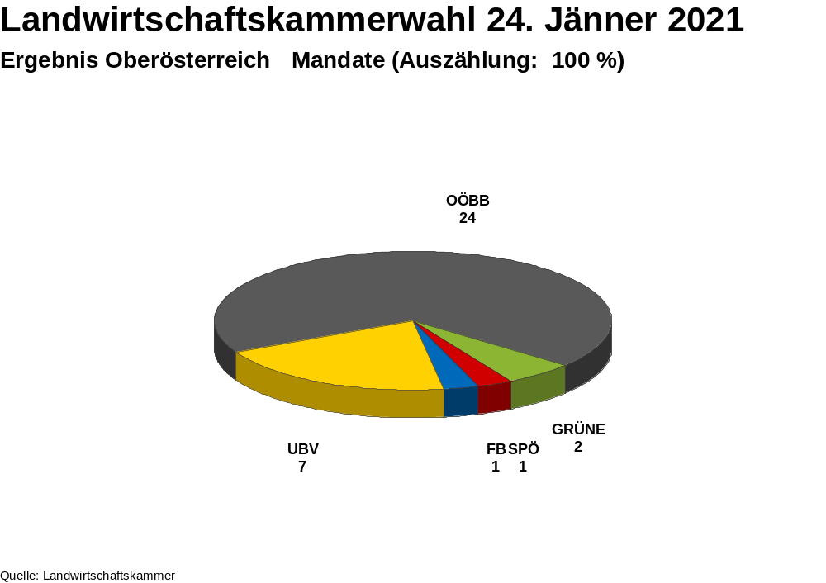
Notes:
erg_4_mand_torte.emf

Slide 5
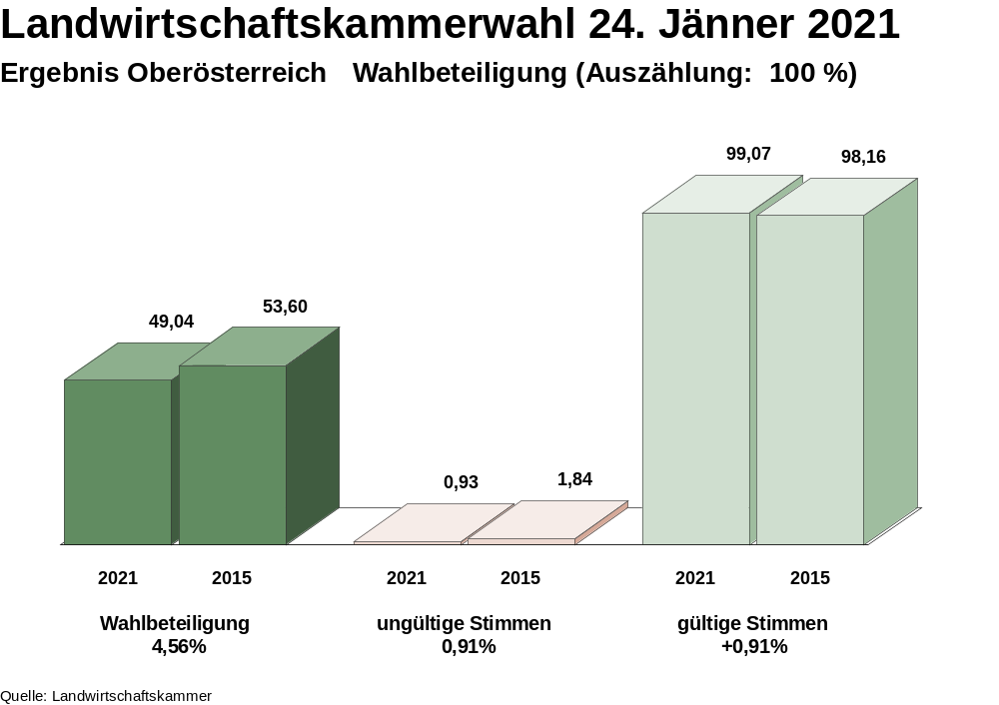
Notes:
erg_4_wb.emf

Slide 6
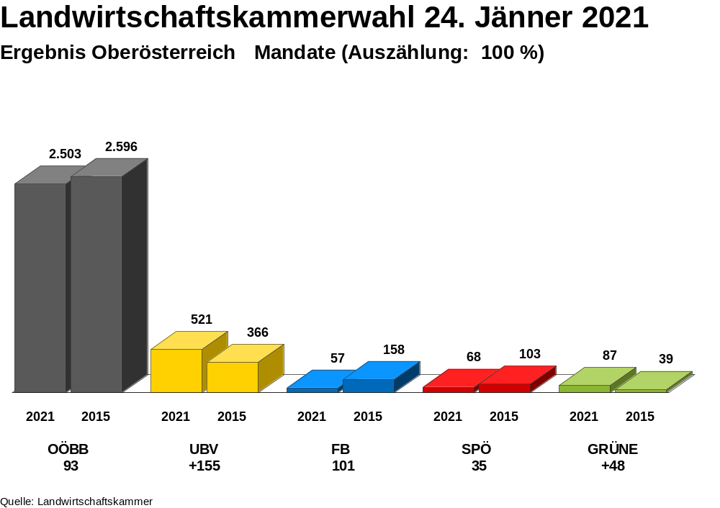
Notes:
erg_400_mand.emf

Slide 7
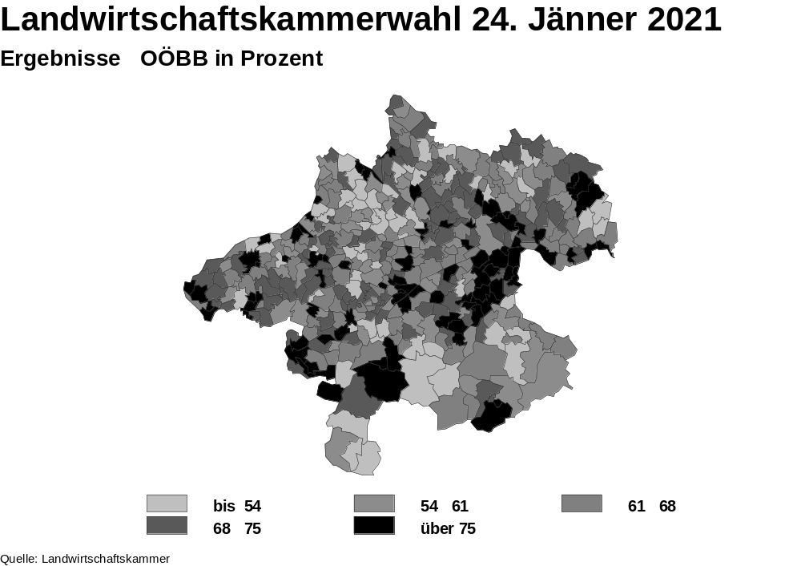
Notes:
map_OOEBB_pct.emf

Slide 8
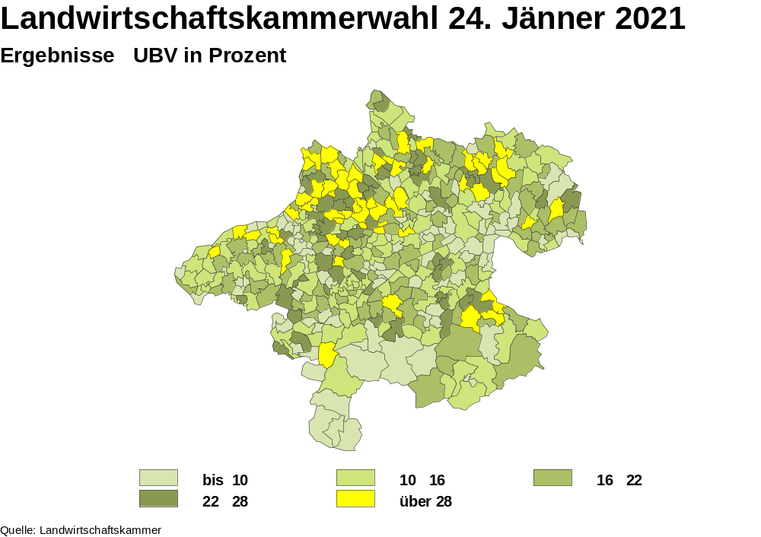
Notes:
map_UBV_pct.emf

Slide 9
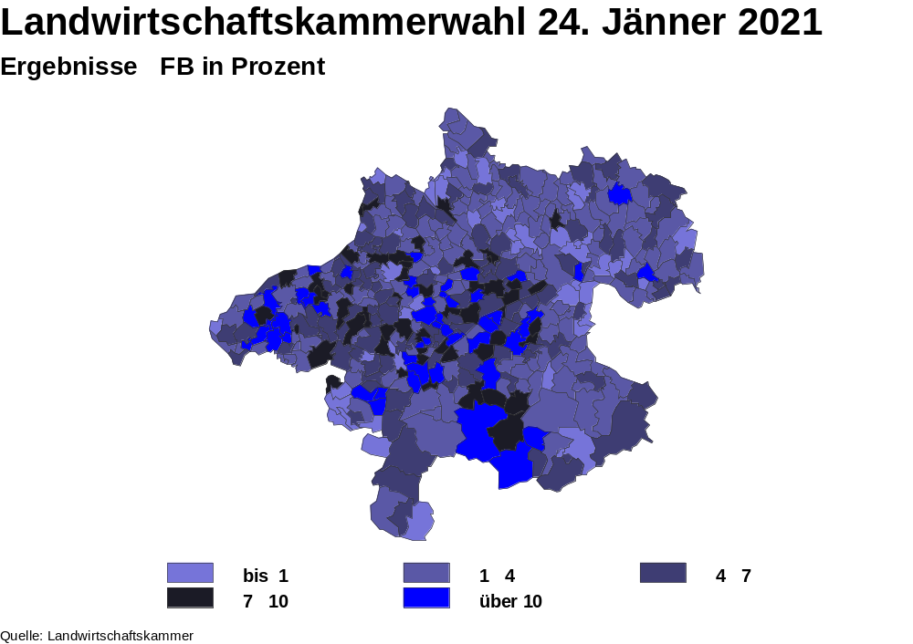
Notes:
map_FB_pct.emf

Slide 10
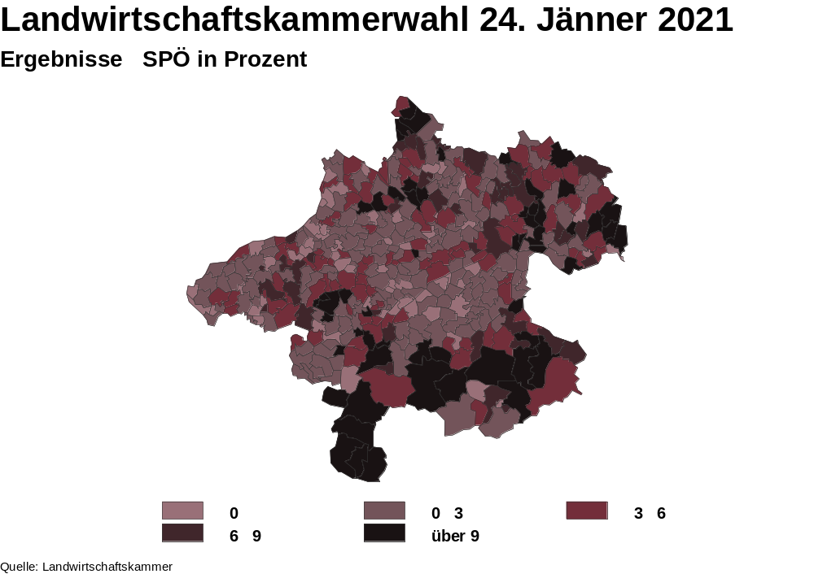
Notes:
map_SPOE_pct.emf

Slide 11
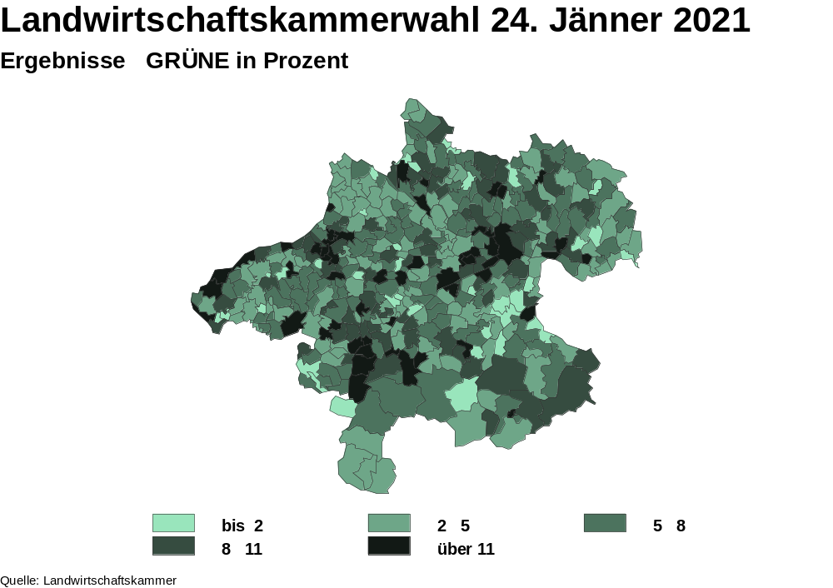
Notes:
map_GRUENE_pct.emf

Slide 12
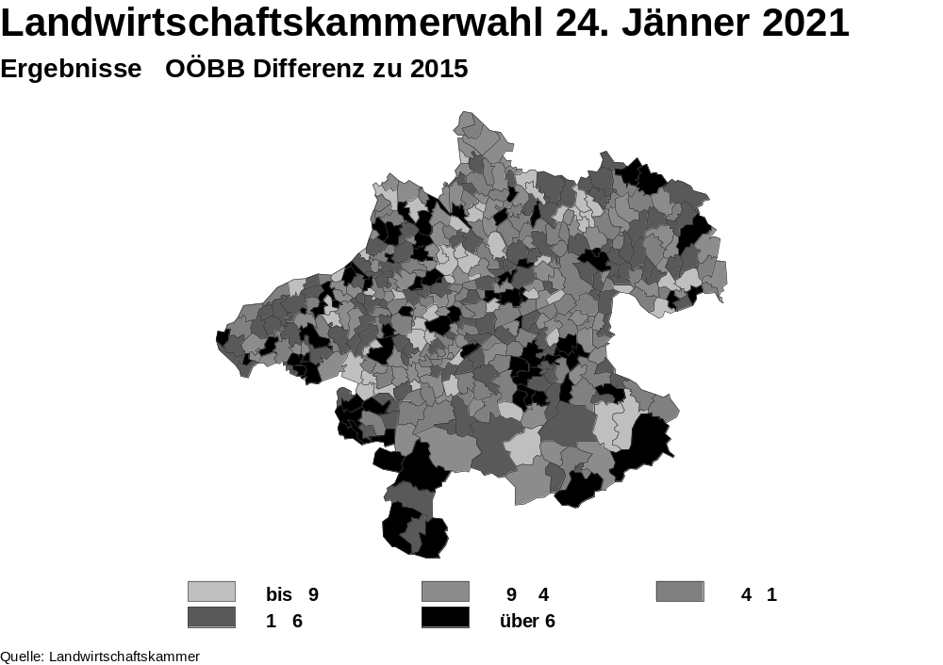
Notes:
map_OOEBB_diff.emf

Slide 13
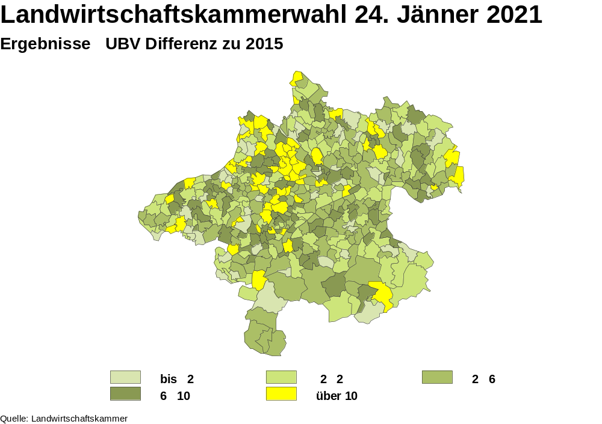
Notes:
map_UBV_diff.emf

Slide 14
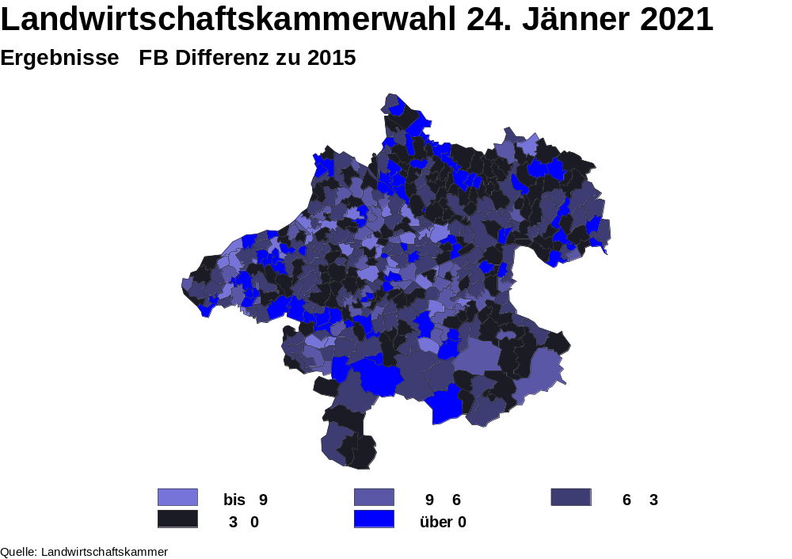
Notes:
map_fb_diff.emf

Slide 15
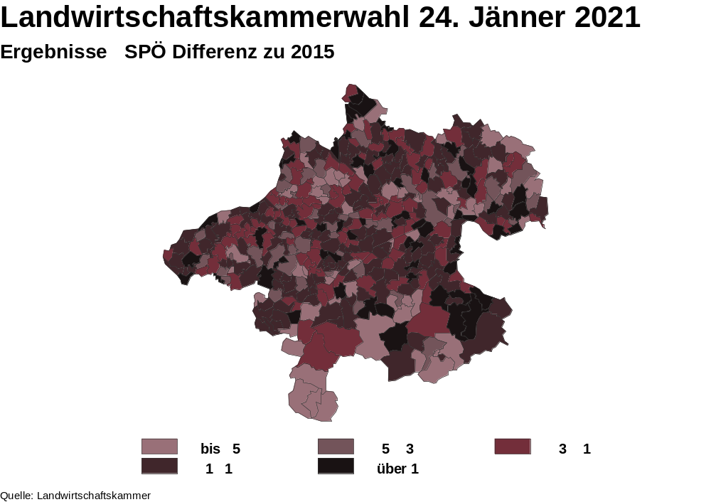
Notes:
map_spoe_diff.emf

Slide 16
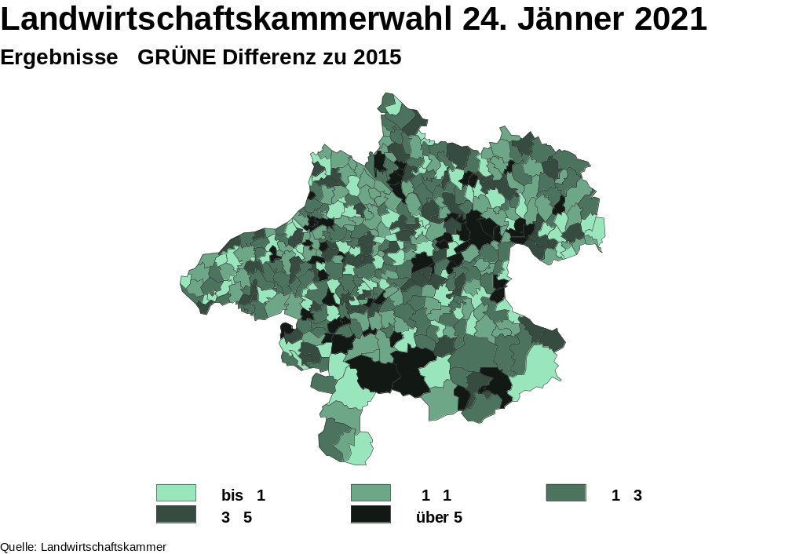
Notes:
map_gruene_diff.emf

Slide 17
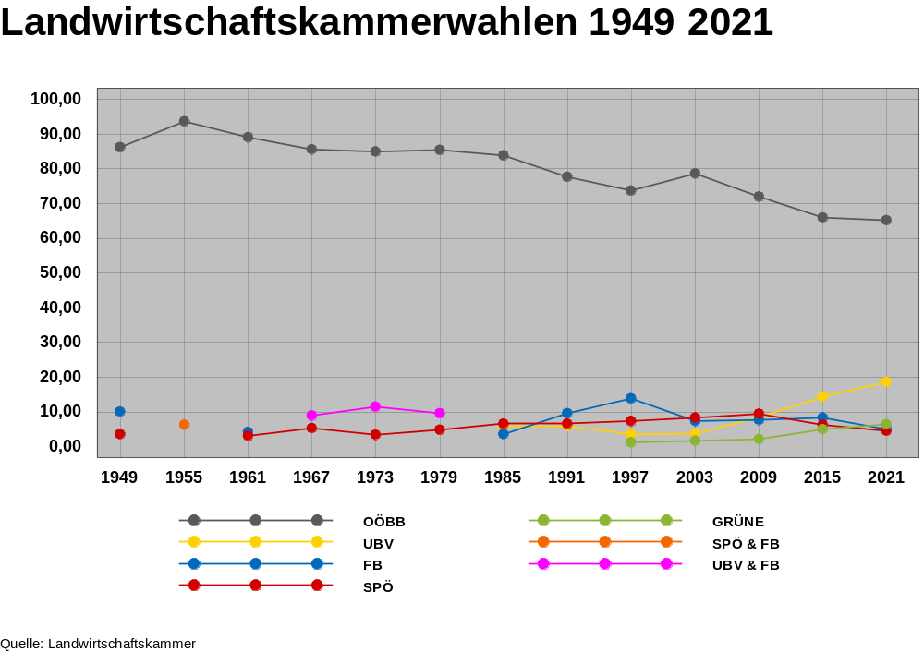
Notes:
history.emf

